Slide 1
Unit 2

Slide 2
Problem-solving agent
Problem-solving agent
A kind of goal-based agent
It solves problem by
finding sequences of actions that lead to desirable states (goals)
To solve a problem,
the first step is the goal formulation, based on the current situation

Slide 3
Building goal-based agents
To build a goal-based agent we need to answer the following questions:
What is the goal to be achieved?
What are the actions?
What is the representation?
E.g., what relevant information is necessary to encode in order to describe the state of the world, describe the available transitions, and solve the problem?)
Initial
state
Actions
Goal
state

Slide 4
Goal formulation
The goal is formulated
as a set of world states, in which the goal is satisfied
Reaching from initial state → goal state
Actions are required
Actions are the operators
causing transitions between world states
Actions should be abstract enough at a certain degree, instead of very detailed
E.g., turn left VS turn left 30 degree, etc.

Slide 5
Problem formulation
The process of deciding
what actions and states to consider
E.g., driving Amman → Zarqa
in-between states and actions defined
States: Some places in Amman & Zarqa
Actions: Turn left, Turn right, go straight, accelerate & brake, etc.

Slide 6
Search
Because there are many ways to achieve the same goal
Those ways are together expressed as a tree
Multiple options of unknown value at a point,
the agent can examine different possible sequences of actions, and choose the best
This process of looking for the best sequence is called search
The best sequence is then a list of actions, called solution

Slide 7
Search algorithm
Defined as
taking a problem
and returns a solution
Once a solution is found
the agent follows the solution
and carries out the list of actions – execution phase
Design of an agent
“Formulate, search, execute”

Slide 8
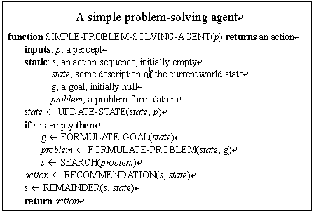

Slide 9
Well-defined problems and solutions
A problem is defined by 5 components:
Initial state
Actions
Transition model or
(Successor functions)
Goal Test.
Path Cost.

Slide 10
Well-defined problems and solutions
A problem is defined by 4 components:
The initial state
that the agent starts in
The set of possible actions
Transition model: description of what each action does.
(successor functions): refer to any state reachable from given state by a single action
Initial state, actions and Transition model define the state space
the set of all states reachable from the initial state by any sequence of actions.
A path in the state space:
any sequence of states connected by a sequence of actions.

Slide 11
Well-defined problems and solutions
The goal test
Applied to the current state to test
if the agent is in its goal
-Sometimes there is an explicit set of possible goal states. (example: in Amman).
-Sometimes the goal is described by the properties
instead of stating explicitly the set of states
Example: Chess
the agent wins if it can capture the KING of the opponent on next move ( checkmate).
no matter what the opponent does

Slide 12
Well-defined problems and solutions
A path cost function,
assigns a numeric cost to each path
= performance measure
denoted by g
to distinguish the best path from others
Usually the path cost is
the sum of the step costs of the individual actions (in the action list)

Slide 13
Well-defined problems and solutions
Together a problem is defined by
Initial state
Actions
Successor function
Goal test
Path cost function
The solution of a problem is then
a path from the initial state to a state satisfying the goal test
Optimal solution
the solution with lowest path cost among all solutions

Slide 14

Outline
Problem solving
Problem types Problem formulation Example problems
Basic search algorithms
B. Beckert: Einführung in die KI / KI für IM – p.

Slide 15
Problem solving
Offline problem solving
Acting only with complete knowledge of problem and solution
Online problem solving
Acting without complete knowledge
Here
Here we are concerned with offline problem solving only
B. Beckert: Einführung in die KI / KI für IM – p.

Slide 16
Example: Travelling in Romania
Scenario
On holiday in Romania; currently in Arad Flight leaves tomorrow from Bucharest
B. Beckert: Einführung in die KI / KI für IM – p.4

Slide 17
Example: Travelling in Romania
Scenario
On holiday in Romania; currently in Arad Flight leaves tomorrow from Bucharest
Goal
Be in Bucharest
B. Beckert: Einführung in die KI / KI für IM – p.4

Slide 18
Example: Travelling in Romania
Scenario
On holiday in Romania; currently in Arad Flight leaves tomorrow from Bucharest
Goal
Be in Bucharest
Formulate problem
States: various cities
Actions: drive between cities
B. Beckert: Einführung in die KI / KI für IM – p.4

Slide 19
Example: Travelling in Romania
Scenario
On holiday in Romania; currently in Arad Flight leaves tomorrow from Bucharest
Goal
Be in Bucharest
Formulate problem
States: various cities
Actions: drive between cities
Solution
Appropriate sequence of cities
e.g.: Arad, Sibiu, Fagaras, Bucharest
B. Beckert: Einführung in die KI / KI für IM – p.4

Slide 20
Example: Travelling in Romania
Oradea
Neamt
Zerind
Iasi
Arad
Sibiu
Fagaras
Vaslui
Timisoara
Rimnicu Vilcea
Lugoj
Pitesti
Hirsova
Mehadia
Urziceni
Bucharest
Dobreta
Craiova
Eforie
Giurgiu
B. Beckert: Einführung in die KI / KI für IM – p.5

Slide 21
Problem types
Single-state problem
observable
deterministic
static
discrete
(at least the initial state)
Multiple-state problem
partially observable
deterministic
static
discrete
(initial state not observable)
Contingency problem
partially observable
non-deterministic
(initial state not observable)
B. Beckert: Einführung in die KI / KI für IM – p.6

Slide 22
















Example: vacuum-cleaner world
Single-state Start in: 5 Solution:
1
2
3
4
5
6
7
8
B. Beckert: Einführung in die KI / KI für IM – p.7

Slide 23
Example: vacuum-cleaner world
Single-state Start in: 5 Solution:
1
2
[right, suck ]
3
4
5
6
7
8
B. Beckert: Einführung in die KI / KI für IM – p.7

Slide 24
Example: vacuum-cleaner world
Single-state Start in: 5 Solution:
1
2
[right, suck ]
3
4
Multiple-state
Start in: {1, 2, 3, 4, 5, 6, 7, 8}
Solution:
5
6
7
8
B. Beckert: Einführung in die KI / KI für IM – p.7

Slide 25














Example: vacuum-cleaner world
Single-state Start in: 5 Solution:
1
2
[right, suck ]
3
4
Multiple-state
Start in: {1, 2, 3, 4, 5, 6, 7, 8}
Solution: [right, suck, left, suck ]
5
6
7
8
right suck left suck
→ {2, 4, 6, 8}
→ {4, 8}
→ {3, 7}
→ {7}
B. Beckert: Einführung in die KI / KI für IM – p.7

Slide 26















Example: vacuum-cleaner world
Contingency | 1 |  |  | 2
Murphy’s Law: suck can dirty a clean carpet | 3 |  |  | 4
Local sensing: dirty /not dirty at location only | 5 |  |  | 6
Start in: {1, 3} | 7 |  |  | 8
Solution:
B. Beckert: Einführung in die KI / KI für IM – p.8

Slide 27
Example: vacuum-cleaner world
Contingency | 1 |  |  | 2
Murphy’s Law: suck can dirty a clean carpet | 3 |  |  | 4
Local sensing: dirty /not dirty at location only | 5 |  |  | 6
Start in: {1, 3} | 7 |  |  | 8
Solution: [suck, right, suck ]
suck right suck
→ {5, 7}
→ {6, 8}
→ {6, 8}
Improvement: [suck, right, if dirt then suck ] (decide whether in 6 or 8 using local sensing)
B. Beckert: Einführung in die KI / KI für IM – p.8

Slide 28
Single-state problem formulation
Defined by the following four items
1. Initial state
Example:
Arad
2. Successor function S
Example:
S(Arad) = { ⟨goZerind, Zerind⟩, ⟨goSibiu, Sibiu⟩, . . . }
3. Goal test
x = Bucharest noDirt(x)
(explicit test) (implicit test)
Example:
4. Path cost
(optional)
Example:
sum of distances, number of operators executed, etc.

Slide 29
Single-state problem formulation
Solution
A sequence of operators
leading from the initial state to a goal state

Slide 30
Selecting a state space
Abstraction
Real world is absurdly complex
State space must be abstracted for problem solving
(Abstract) state Set of real states
(Abstract) operator
Complex combination of real actions
Example: Arad → Zerind represents complex set of possible routes
(Abstract) solution
Set of real paths that are solutions in the real world

Slide 31
Example: The 8-puzzle
7 | 2 | 4
5 |  | 6
8 | 3 | 1
1 | 2 | 3
4 | 5 | 6
7 | 8
5
Start State
Goal State
States
Actions Goal test Path cost
B. Beckert: Einführung in die KI / KI für IM – p.12

Slide 32
Example: The 8-puzzle
7 | 2 | 4
5 |  | 6
8 | 3 | 1
1 | 2 | 3
4 | 5 | 6
7 | 8
5
Start State
Goal State
States
integer locations of tiles
Actions
Goal test Path cost
B. Beckert: Einführung in die KI / KI für IM – p.12

Slide 33
Example: The 8-puzzle
7 | 2 | 4
5 |  | 6
8 | 3 | 1
1 | 2 | 3
4 | 5 | 6
7 | 8
5
Start State
Goal State
States
integer locations of tiles
Actions
left, right, up, down
Goal test
Path cost
B. Beckert: Einführung in die KI / KI für IM – p.12

Slide 34
Example: The 8-puzzle
7 | 2 | 4
5 |  | 6
8 | 3 | 1
1 | 2 | 3
4 | 5 | 6
7 | 8
5
Start State
Goal State
States
integer locations of tiles
Actions
left, right, up, down
Goal test
= goal state?
Path cost
B. Beckert: Einführung in die KI / KI für IM – p.12

Slide 35
Example: The 8-puzzle
7 | 2 | 4
5 |  | 6
8 | 3 | 1
1 | 2 | 3
4 | 5 | 6
7 | 8
5
Start State
Goal State
States
integer locations of tiles
Actions
left, right, up, down
Goal test
= goal state?
Path cost
1 per move
B. Beckert: Einführung in die KI / KI für IM – p.12

Slide 36
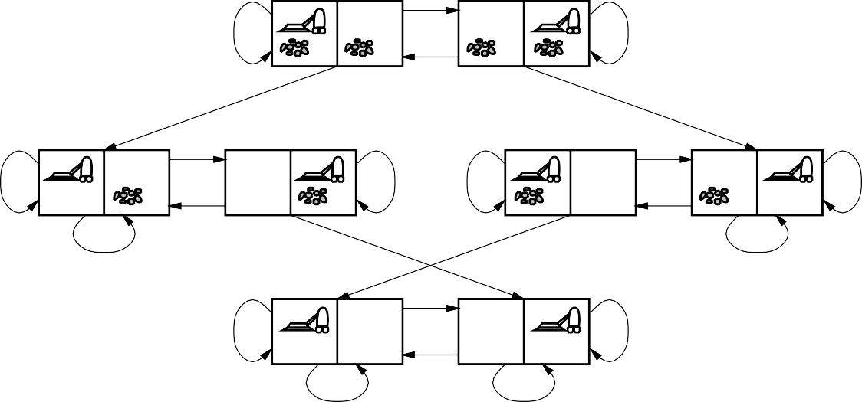
Example: Vacuum-cleaner
L
R
R
L
S
S
L
R
R
L
R
R
L
L
S
S
S
S
L
R
R
L
S
S
States
Actions Goal test Path cost
B. Beckert: Einführung in die KI / KI für IM – p.13

Slide 37
Example: Vacuum-cleaner
L
R
R
L
S
S
L
R
R
L
R
R
L
L
S
S
S
S
L
R
R
L
S
S
States
integer dirt and robot locations
Actions
Goal test Path cost
B. Beckert: Einführung in die KI / KI für IM – p.13

Slide 38
Example: Vacuum-cleaner
L
R
R
L
S
S
L
R
R
L
R
R
L
L
S
S
S
S
L
R
R
L
S
S
States
integer dirt and robot locations
Actions
left, right, suck, noOp
Goal test
Path cost
B. Beckert: Einführung in die KI / KI für IM – p.13

Slide 39
Example: Vacuum-cleaner
L
R
R
L
S
S
L
R
R
L
R
R
L
L
S
S
S
S
L
R
R
L
S
S
States
integer dirt and robot locations
Actions
left, right, suck, noOp
Goal test
not dirty ?
Path cost
B. Beckert: Einführung in die KI / KI für IM – p.13

Slide 40
Example: Vacuum-cleaner
L
R
R
L
S
S
L
R
R
L
R
R
L
L
S
S
S
S
L
R
R
L
S
S
States
integer dirt and robot locations
Actions
left, right, suck, noOp
Goal test
not dirty ?
Path cost
1 per operation
(0 for noOp)
B. Beckert: Einführung in die KI / KI für IM – p.13

Slide 41
Tree search algorithms
Offline
Simulated exploration of state space in a search tree by generating successors of already-explored states
function TREE-SEARCH( problem, strategy) returns a solution or failure initialize the search tree using the initial state of problem
loop do
if there are no candidates for expansion then return failure choose a leaf node for expansion according to strategy
if the node contains a goal state then return the corresponding solution
else
expand the node and add the resulting nodes to the search tree
end

Slide 42
Tree search: Example
Arad
Sibiu
Timisoara
Zerind
Arad
Fagaras
Oradea
Rimnicu Vilcea
Arad
Lugoj
Arad
Oradea
B. Beckert: Einführung in die KI / KI für IM – p.16

Slide 43
Tree search: Example
Arad
Sibiu
Timisoara
Zerind
Arad
Fagaras
Oradea
Rimnicu Vilcea
Arad
Lugoj
Arad
Oradea
B. Beckert: Einführung in die KI / KI für IM – p.16

Slide 44
Tree search: Example
Arad
Sibiu
Timisoara
Zerind
Arad
Fagaras
Oradea
Rimnicu Vilcea
Arad
Lugoj
Arad
Oradea
B. Beckert: Einführung in die KI / KI für IM – p.16

Slide 45
Implementation: States vs. nodes
State
A (representation of) a physical configuration
Node
A data structure constituting part of a search tree (includes parent, children, depth, path cost, etc.)
parent
State
5 | 4
6 | 1 | 8
7 | 3 | 2
Node
depth = 6
g = 6
5
4
6
1
8
state
children
7
3
2

Slide 46
Implementation of search algorithms
function TREE-SEARCH( problem, fringe) returns a solution or failure
fringe ← INSERT(MAKE-NODE(INITIAL-STATE[problem]),fringe)
loop do
if fringe is empty then return failure
node ← REMOVE-FIRST(fringe)
if GOAL-TEST[problem] applied to STATE(node) succeeds then return node
else
fringe ← INSERT-ALL(EXPAND(node, problem), fringe)
end
fringe State Expand
queue of nodes not yet considered
gives the state that is represented by node
creates new nodes by applying possible actions to node

Slide 47
Search strategies
Strategy
Defines the order of node expansion
Important properties of strategies
completeness time complexity space complexity optimality
does it always find a solution if one exists? number of nodes generated/expanded maximum number of nodes in memory does it always find a least-cost solution?
Time and space complexity measured in terms of
b maximum branching factor of the search tree
d depth of a solution with minimal distance to root
m maximum depth of the state space (may be ∞)

Slide 48
Uninformed search strategies
Uninformed search
Use only the information available in the problem definition
Frequently used strategies
Breadth-first search Uniform-cost search Depth-first search Depth-limited search
Iterative deepening search

Slide 49
Formulating problems
Besides the four components for problem formulation
anything else?
Abstraction
the process to take out the irrelevant information
leave the most essential parts to the description of the states
( Remove detail from representation)
Conclusion: Only the most important parts that are contributing to searching are used

Slide 50
Problem-Solving Agents
agents whose task is to solve a particular problem (steps)
goal formulation
what is the goal state
what are important characteristics of the goal state
how does the agent know that it has reached the goal
are there several possible goal states
are they equal or are some more preferable
problem formulation
what are the possible states of the world relevant for solving the problem
what information is accessible to the agent
how can the agent progress from state to state

Slide 51
Example: Romania
On holiday in Romania; currently in Arad.
Flight leaves tomorrow from Bucharest
Formulate goal:
be in Bucharest
Formulate problem:
states: various cities
actions: drive between cities
Find solution:
sequence of cities, e.g., Arad, Sibiu, Fagaras, Bucharest

Slide 52

Example: Romania

Slide 53
Single-state problem formulation
A problem is defined by four items: initial state e.g., "at Arad"
actions or successor function S(x) = set of action–state pairs
e.g., S(Arad) = {<Arad → Zerind, Zerind>, … }
goal test, can be
explicit, e.g., x = "at Bucharest"
implicit, e.g., Checkmate(x)
path cost (additive)
e.g., sum of distances, number of actions executed, etc.
c(x,a,y) is the step cost, assumed to be ≥ 0
A solution is a sequence of actions leading from the initial state to a goal state

Slide 54
Example problems
Toy problems
those intended to illustrate or exercise various problem-solving methods
E.g., puzzle, chess, etc.
Real-world problems
tend to be more difficult and whose solutions people actually care about
E.g., Design, planning, etc.

Slide 55
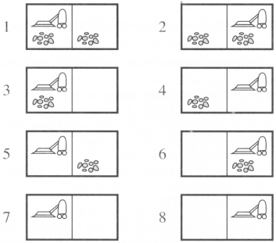
Toy problems
Example: vacuum world
Number of states: 8
Initial state: Any
Number of actions: 4
left, right, suck, noOp
Goal: clean up all dirt
Goal states: {7, 8}
Path Cost:
Each step costs 1

Slide 56
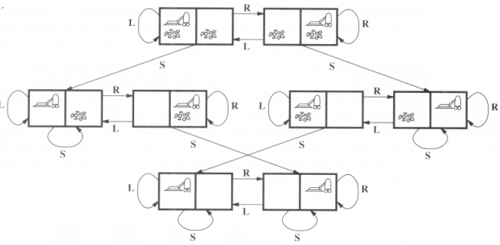

Slide 57
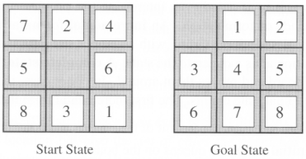
The 8-puzzle

Slide 58
The 8-puzzle
States:
a state description specifies the location of each of the eight tiles and blank in one of the nine squares
Initial State:
Any state in state space
Successor function:
the blank moves Left, Right, Up, or Down
Goal test:
current state matches the goal configuration
Path cost:
each step costs 1, so the path cost is just the length of the path

Slide 59
The 8-queens
There are two ways to formulate the problem
All of them have the common followings:
Goal test: 8 queens on board, not attacking to each other
Path cost: zero

Slide 60
The 8-queens
(1) Incremental formulation
involves operators that augment the state description starting from an empty state
Each action adds a queen to the state
States:
any arrangement of 0 to 8 queens on board
Successor function:
add a queen to any empty square

Slide 61
The 8-queens
(2) Complete-state formulation
starts with all 8 queens on the board
move the queens individually around
States:
any arrangement of 8 queens, one per column in the leftmost columns
Operators: move an attacked queen to a row, not attacked by any other

Slide 62
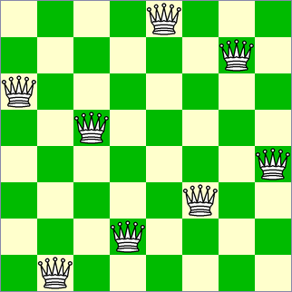
The 8-queens
Conclusion:
the right formulation makes a big difference to the size of the search space

Slide 63
Example: River Crossing
Items: Man, Wolf, Corn, Chicken.
Man wants to cross river with all items.
Wolf will eat Chicken
Chicken will eat corn.
Boat will take max of two.

Slide 64
3.3 Searching for solutions

Slide 65
3.3 Searching for solutions
Finding out a solution is done by
searching through the state space
All problems are transformed
as a search tree
generated by the initial state and successor function

Slide 66
Search tree
Initial state
The root of the search tree is a search node
Expanding
applying successor function to the current state
thereby generating a new set of states
leaf nodes
the states having no successors
Fringe : Set of search nodes that have not been expanded yet.
Refer to next figure

Slide 67
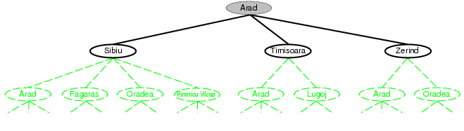
Tree search example

Slide 68
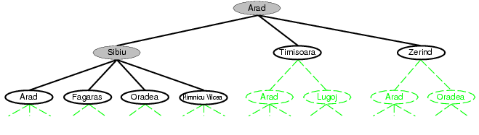
Tree search example

Slide 69
Search tree
The essence of searching
in case the first choice is not correct
choosing one option and keep others for later inspection
Hence we have the search strategy
which determines the choice of which state to expand
good choice → fewer work → faster
Important:
state space ≠ search tree

Slide 70
Search tree
State space
has unique states {A, B}
while a search tree may have cyclic paths: A-B-A-B-A-B- …
A good search strategy should avoid such paths

Slide 71
Search tree
A node is having five components:
STATE: which state it is in the state space
PARENT-NODE: from which node it is generated
ACTION: which action applied to its parent-node to generate it
PATH-COST: the cost, g(n), from initial state to the node n itself
DEPTH: number of steps along the path from the initial state

Slide 72
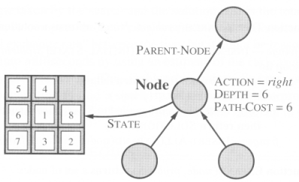

Slide 73
The process of problem-solving using searching consists of the following steps.
Define the problem
Analyze the problem
Identification of possible solutions
Choosing the optimal solution
Implementation
Let’s discuss some of the essential properties of search algorithms.
Properties of search algorithms
Completeness
A search algorithm is said to be complete when it gives a solution or returns any solution for a given random input.
Optimality
If a solution found is best (lowest path cost) among all the solutions identified, then that solution is said to be an optimal one.
Time complexity
The time taken by an algorithm to complete its task is called time complexity. If the algorithm completes a task in a lesser amount of time, then it is an efficient one.
Space complexity
It is the maximum storage or memory taken by the algorithm at any time while searching.
These properties are
also used to compare the efficiency of the different types of searching algorithms.

Slide 74
Measuring problem-solving performance
The evaluation of a search strategy
Completeness:
is the strategy guaranteed to find a solution when there is one?
Optimality:
does the strategy find the highest-quality solution when there are several different solutions?
Time complexity:
how long does it take to find a solution?
Space complexity:
how much memory is needed to perform the search?

Slide 75
Measuring problem-solving performance
In AI, complexity is expressed in
b, branching factor, maximum number of successors of any node
d, the depth of the shallowest goal node.
(depth of the least-cost solution)
m, the maximum length of any path in the state space
Time and Space is measured in
number of nodes generated during the search
maximum number of nodes stored in memory

Slide 76
Measuring problem-solving performance
For effectiveness of a search algorithm
we can just consider the total cost
The total cost = path cost (g) of the solution found + search cost
search cost = time necessary to find the solution
Tradeoff:
(long time, optimal solution with least g)
vs. (shorter time, solution with slightly larger path cost g)

Slide 77
3.4 Uninformed search strategies

Slide 78
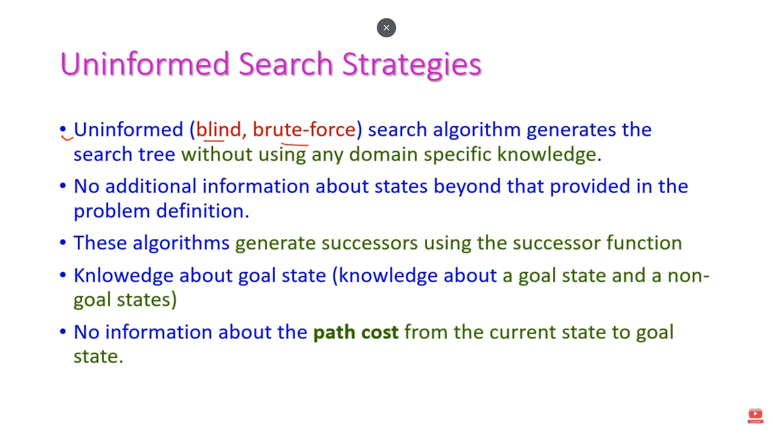

Slide 79


Slide 80
3.4 Uninformed search strategies
Uninformed search
no information about the number of steps
or the path cost from the current state to the goal
search the state space blindly
Informed search, or heuristic search
a cleverer strategy that searches toward the goal,
based on the information from the current state so far

Slide 81
Uninformed search strategies
Breadth-first search
Uniform cost search
Depth-first search
Depth-limited search
Iterative deepening search
Bidirectional search

Slide 82
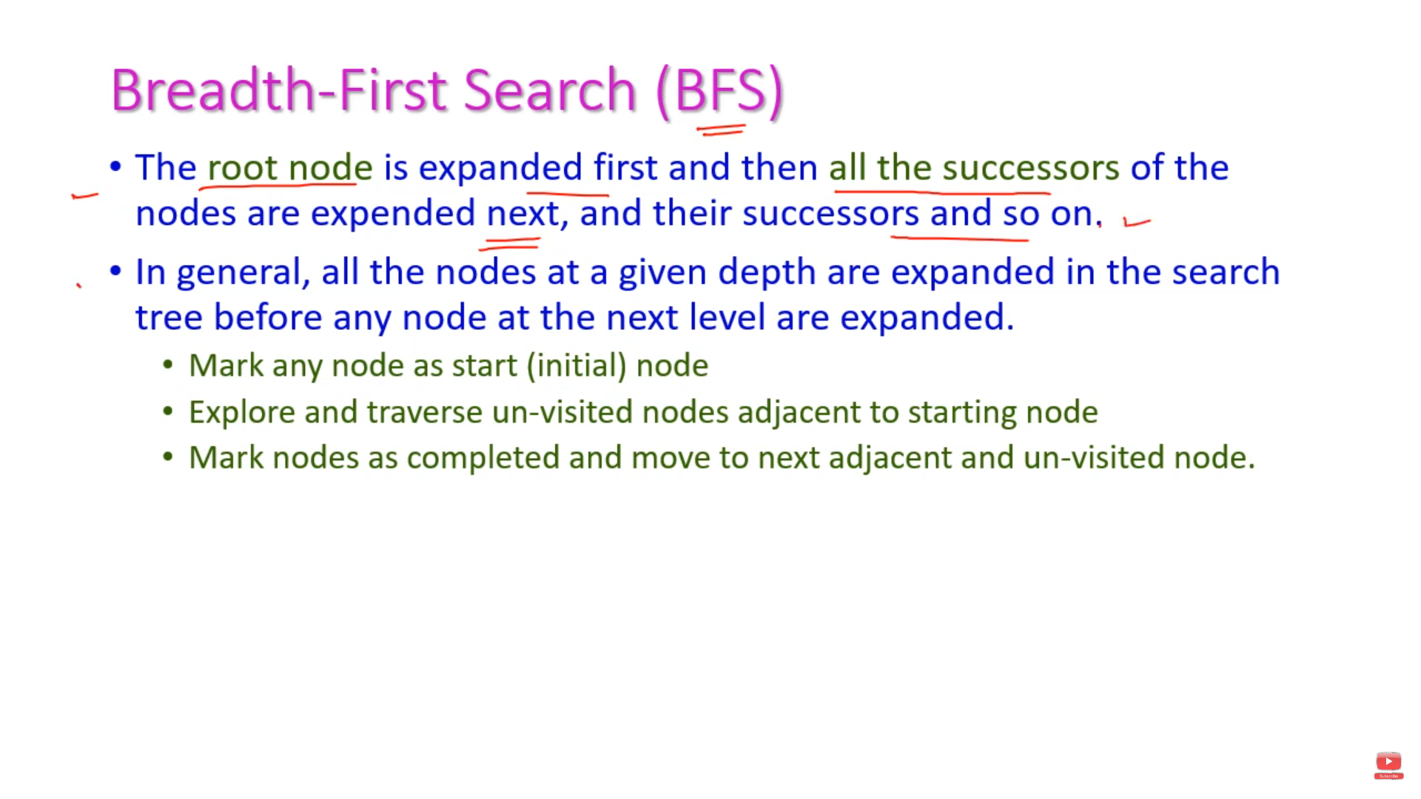

Slide 83
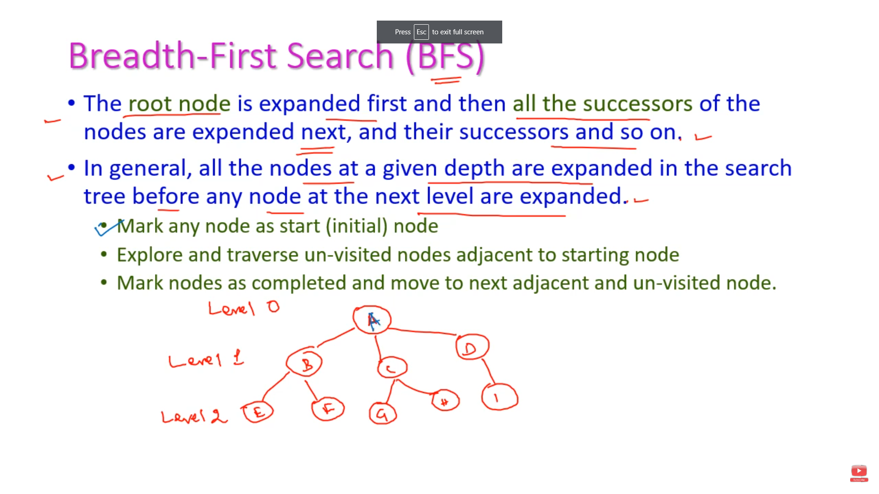

Slide 84
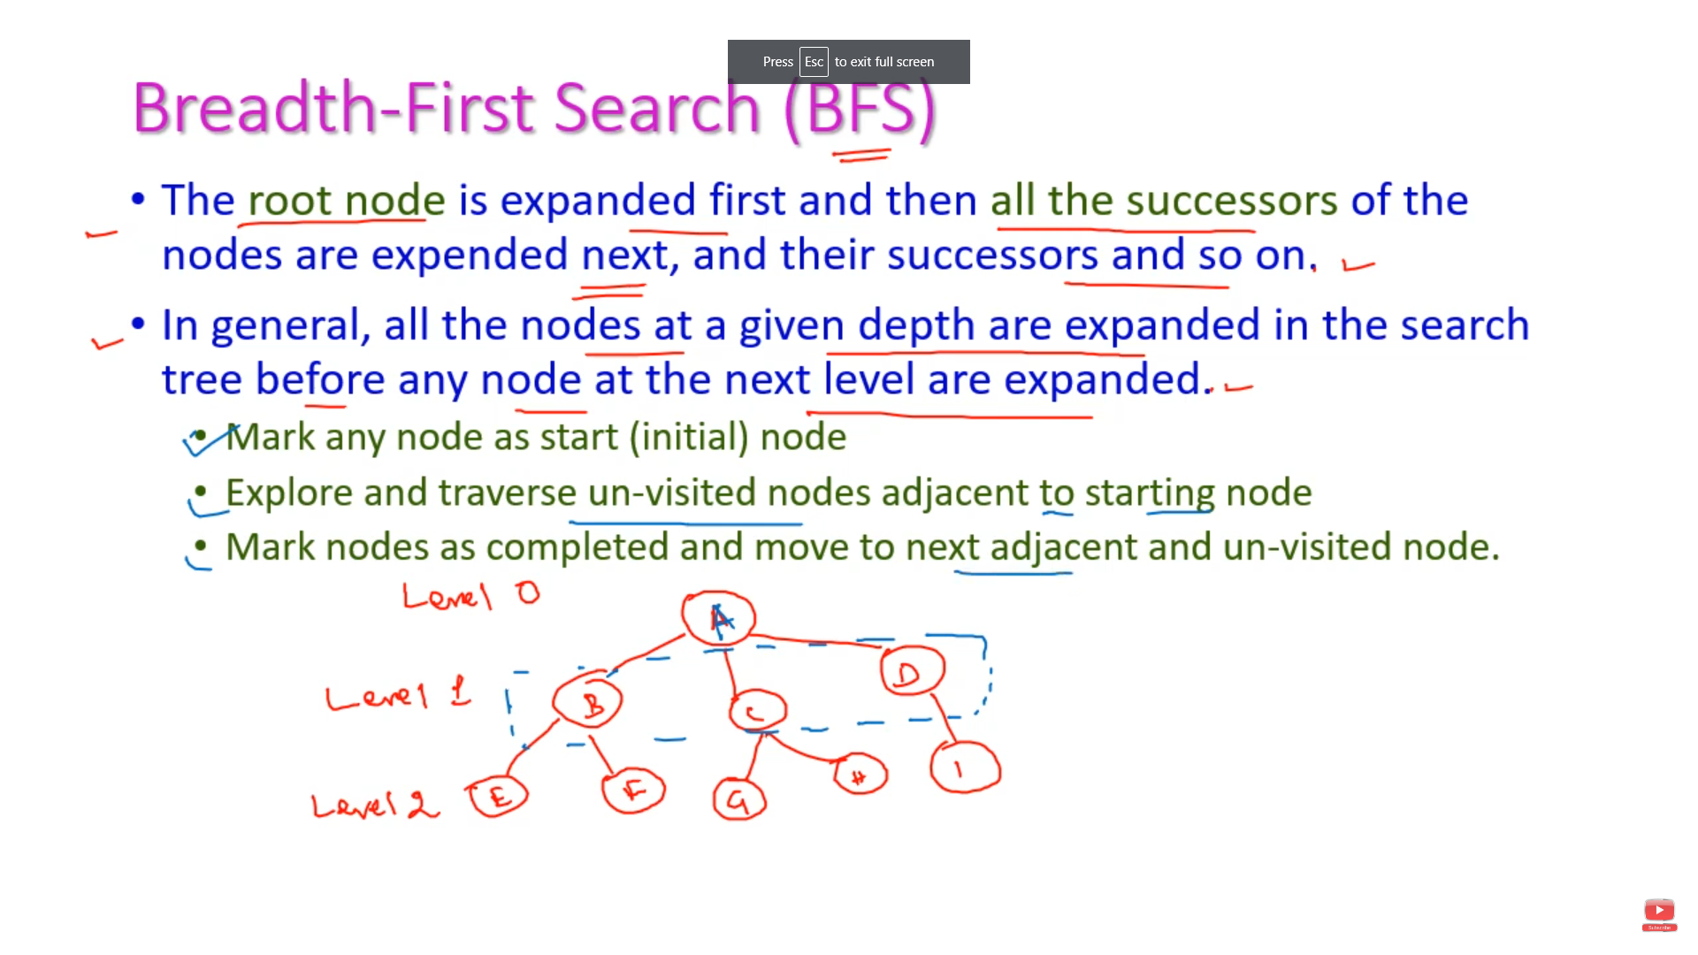

Slide 85
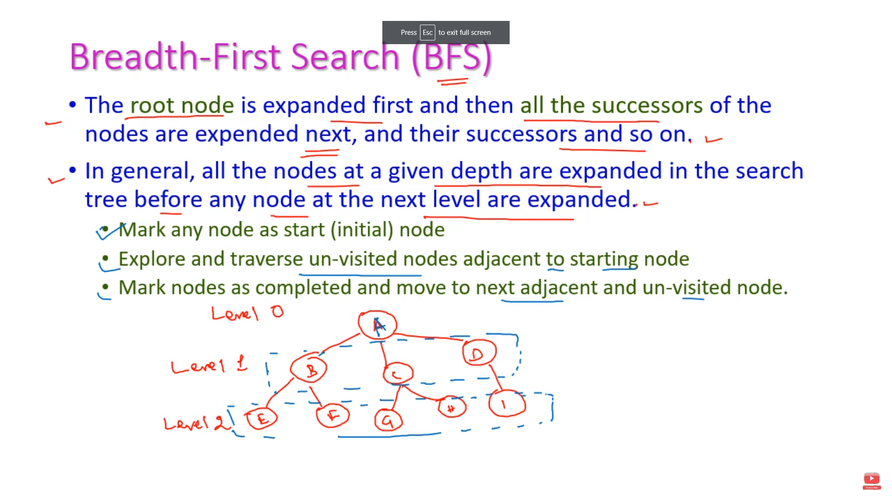

Slide 86
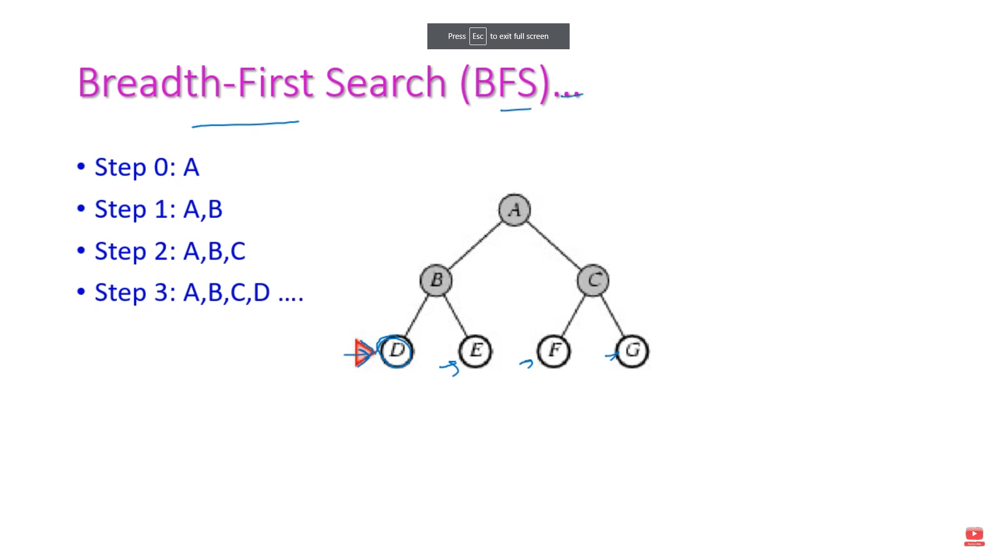

Slide 87
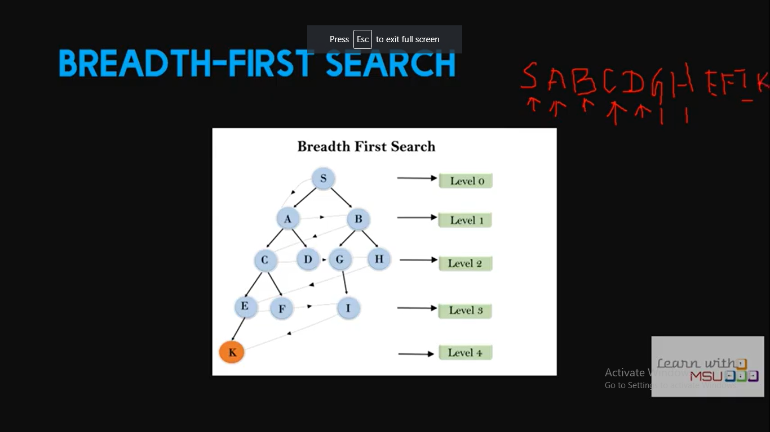

Slide 88
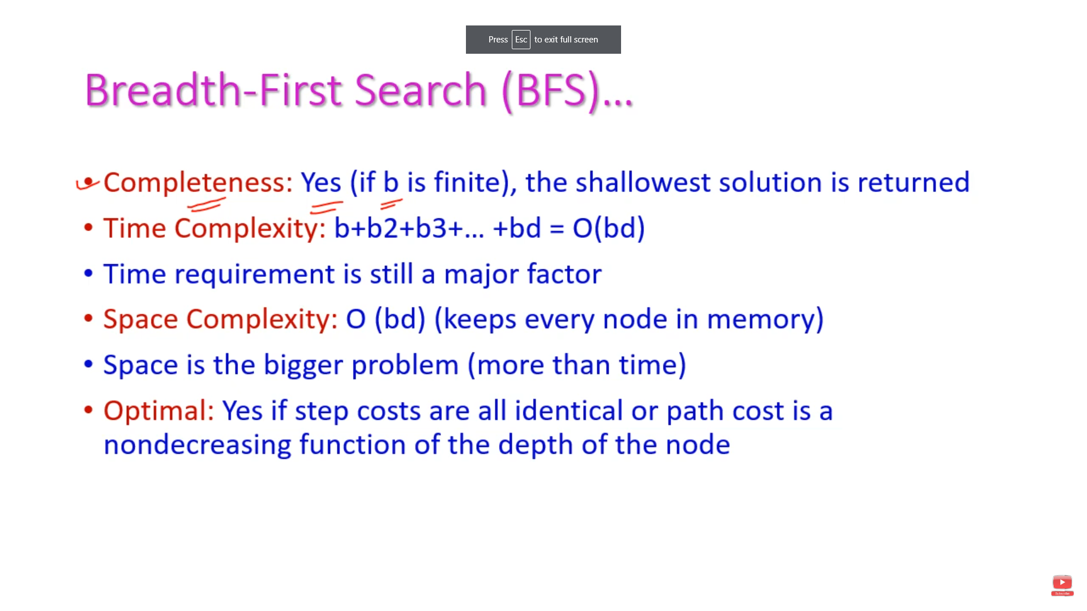

Slide 89
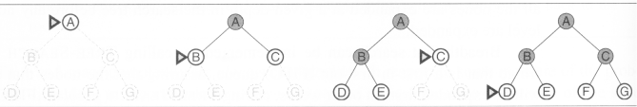
Breadth-first search
The root node is expanded first (FIFO)
All the nodes generated by the root node are then expanded
And then their successors and so on

Slide 90
Breadth-first search
S
A
D
B
D
A
E
C
E
E
B
B
F
11
D
F
B
F
C
E
A
C
G
14
17
15
15
13
G
C
G
F
19
19
17
G
25

Slide 91
Breadth-First Strategy
New nodes are inserted at the end of FRINGE
1
2
3
FRINGE = (1)
4
5
6
7

Slide 92
Breadth-First Strategy
New nodes are inserted at the end of FRINGE
1
2
3
FRINGE = (2, 3)
4
5
6
7

Slide 93
Breadth-First Strategy
New nodes are inserted at the end of FRINGE
1
2
3
FRINGE = (3, 4, 5)
4
5
6
7

Slide 94
Breadth-First Strategy
New nodes are inserted at the end of FRINGE
1
2
3
FRINGE = (4, 5, 6, 7)
4
5
6
7

Slide 95
Breadth-first search (Analysis)
Breadth-first search
Complete – find the solution eventually
Optimal, if step cost is 1
The disadvantage
if the branching factor of a node is large,
for even small instances (e.g., chess)
the space complexity and the time complexity are enormous

Slide 96
Properties of breadth-first search
Complete? Yes (if b is finite)
Time? 1+b+b²+b³+… +b^{d} = b(b^{d}-1) = O(b^{d+1})
Space? O(b^{d+1}) (keeps every node in memory)
Optimal? Yes (if cost = 1 per step)
Space is the bigger problem (more than time)

Slide 97
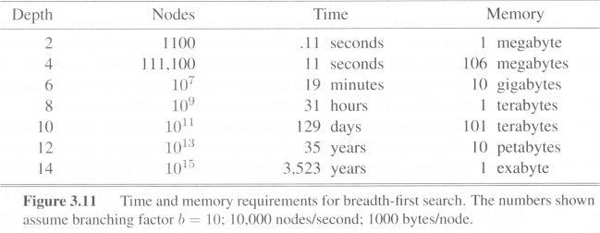
Breadth-first search (Analysis)
assuming 10000 nodes can be processed per second, each with 1000 bytes of storage

Slide 98
Uniform cost search
Breadth-first finds the shallowest goal state
but not necessarily be the least-cost solution
work only if all step costs are equal
Uniform cost search
modifies breadth-first strategy
by always expanding the lowest-cost node
The lowest-cost node is measured by the path cost g(n)

Slide 99
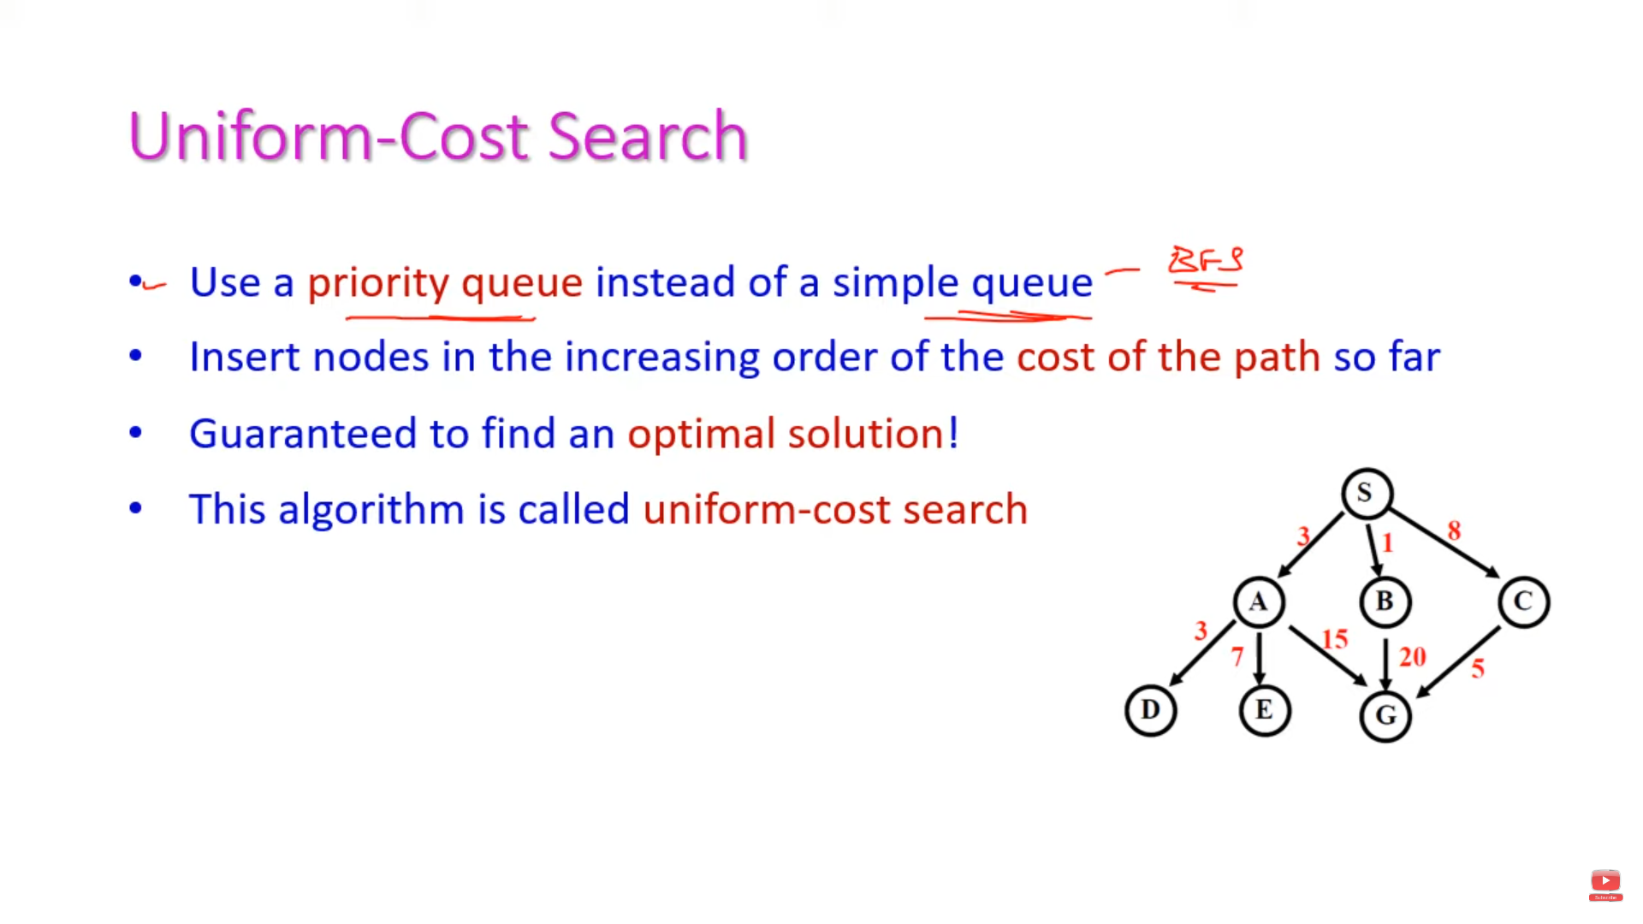

Slide 100
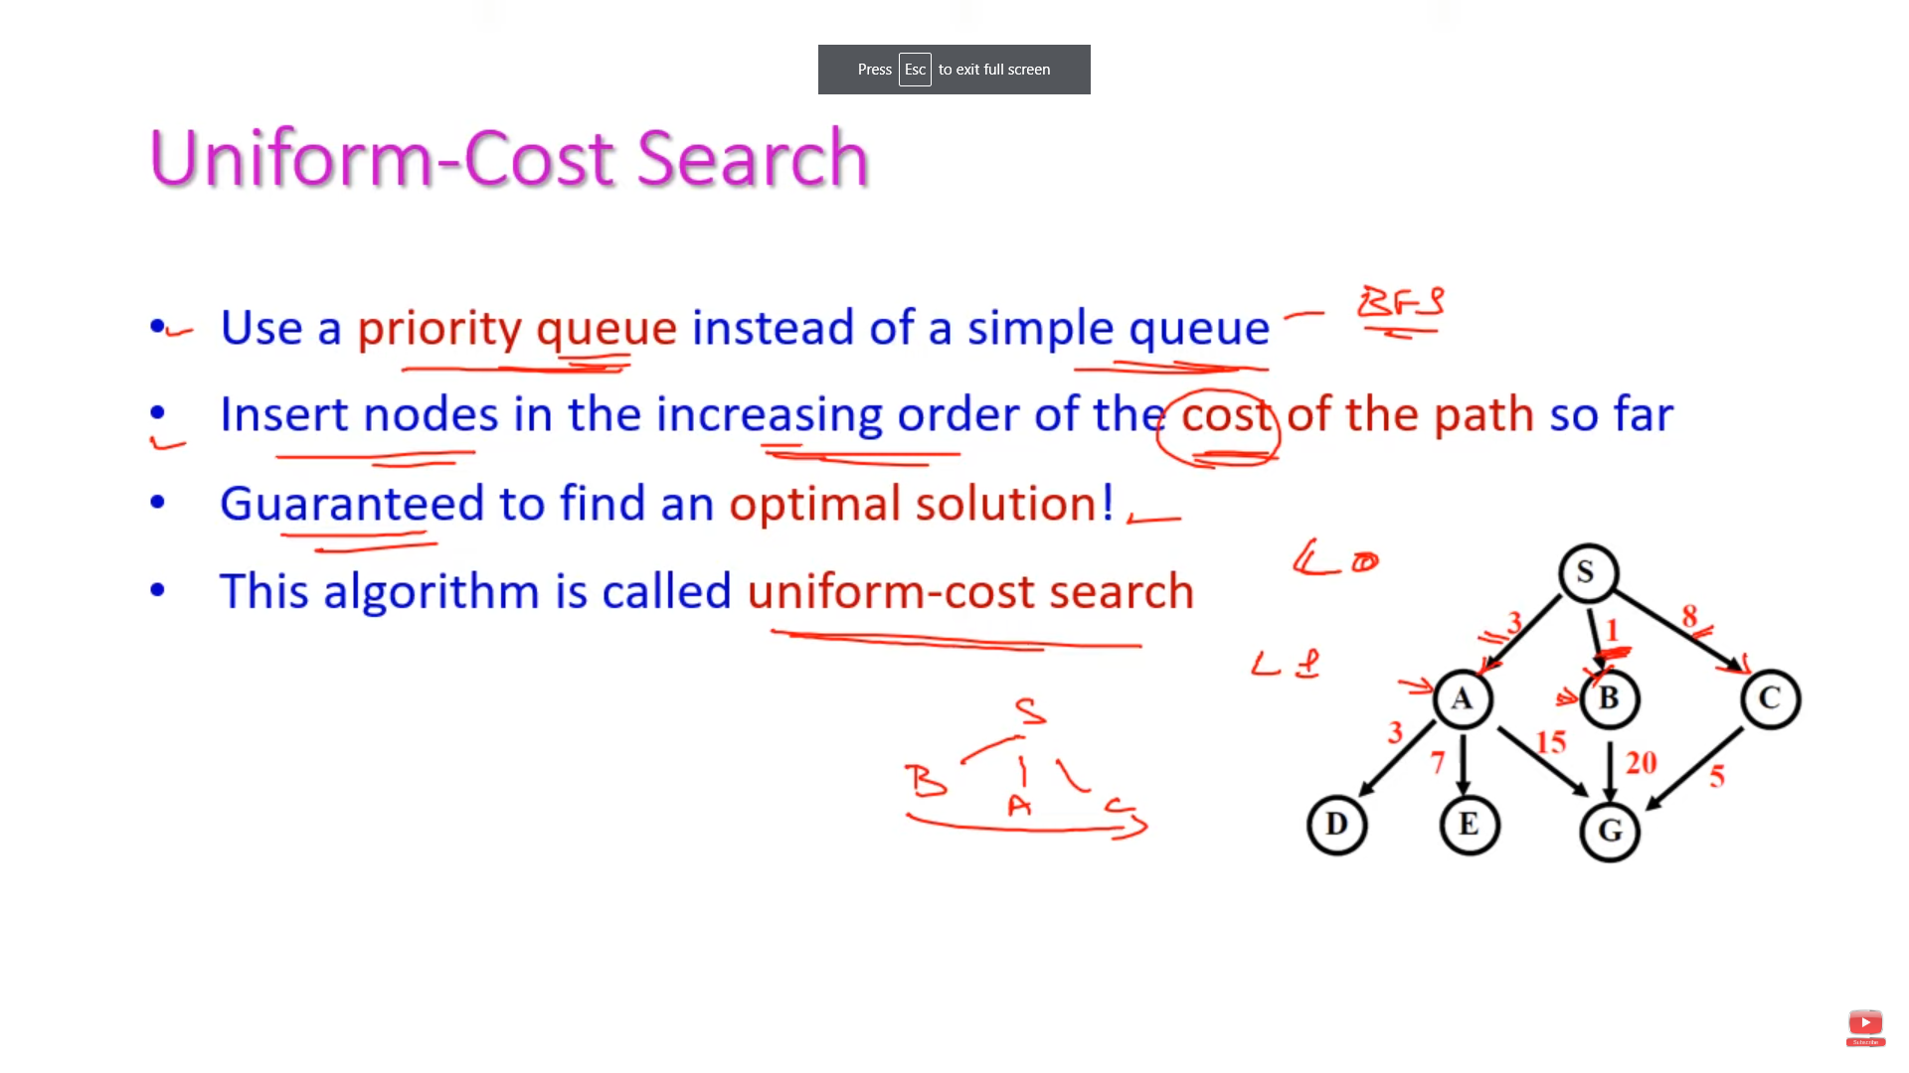

Slide 101
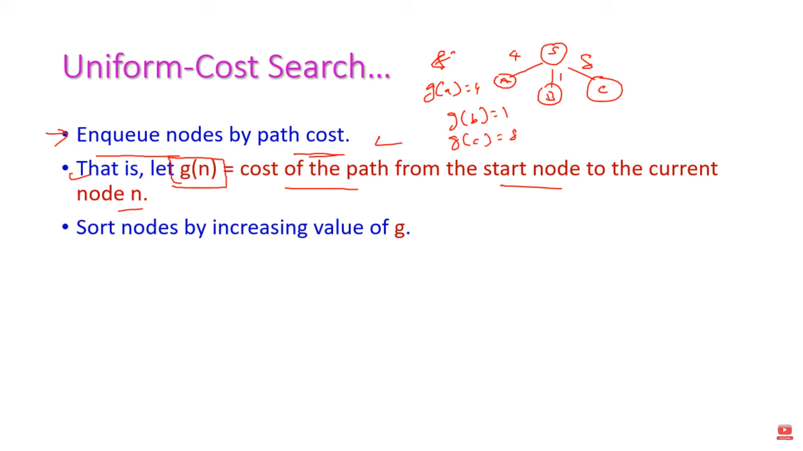

Slide 102
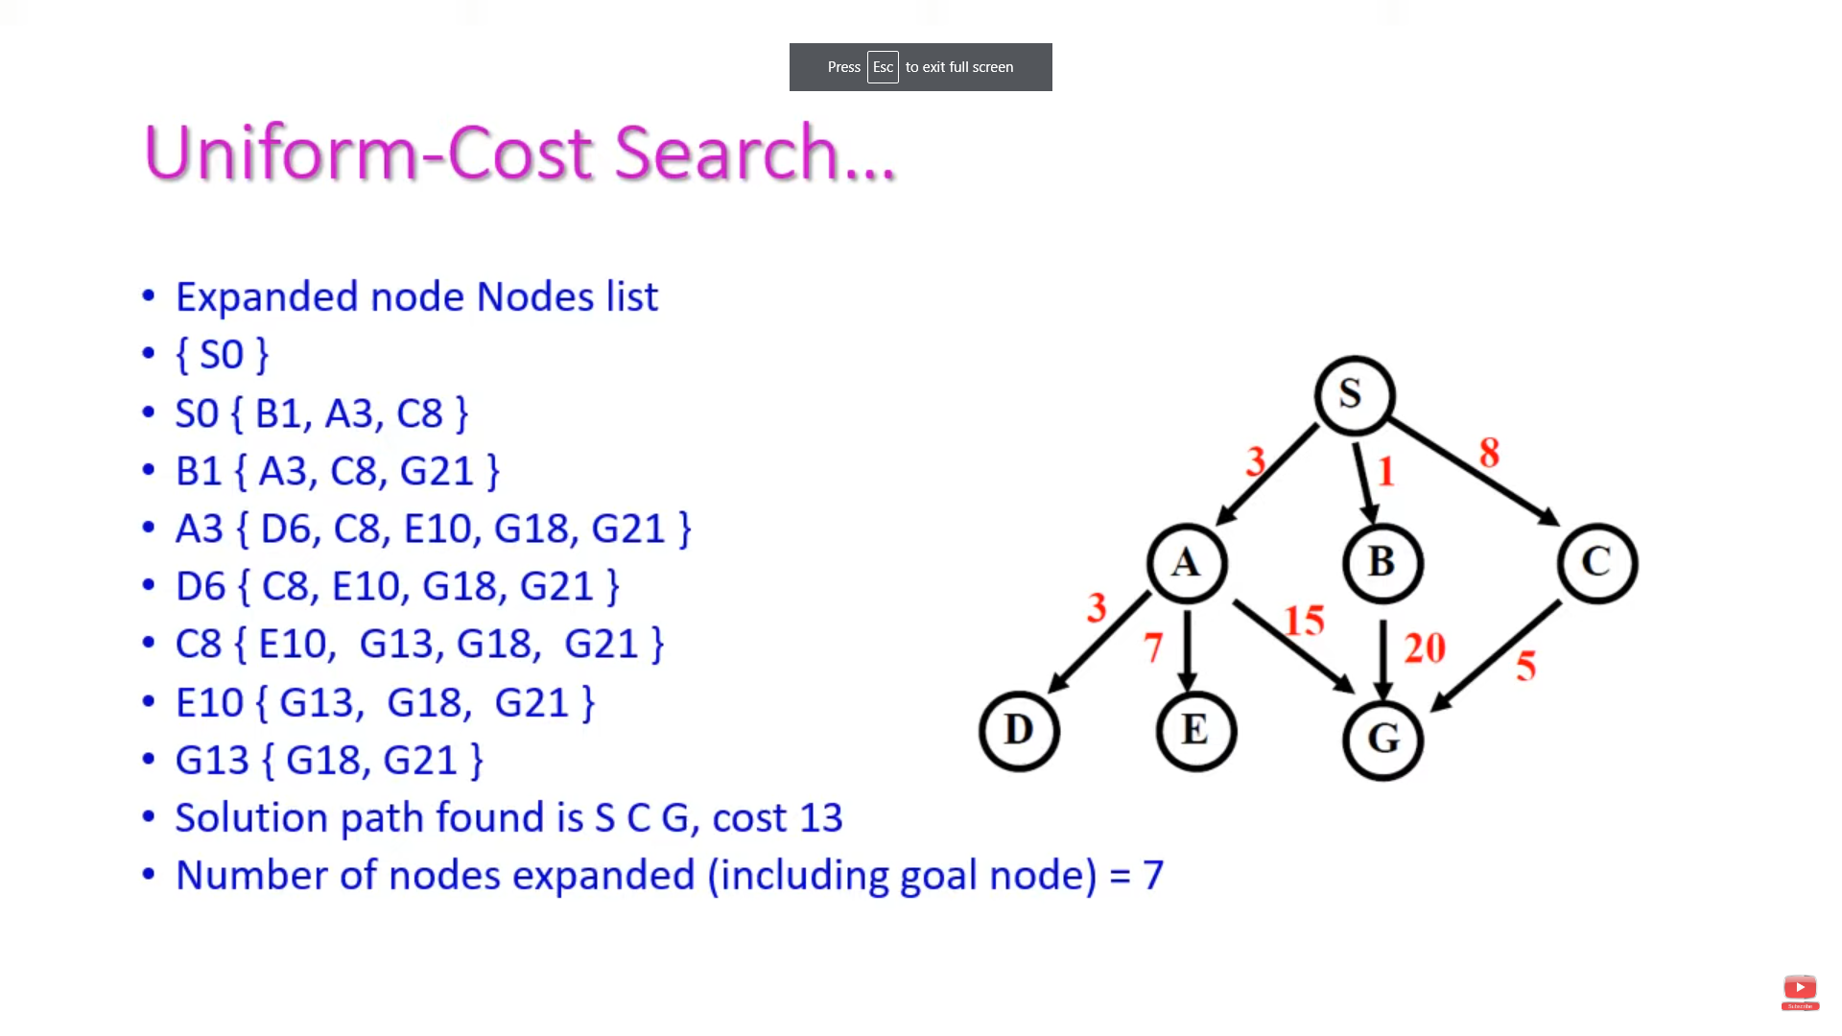

Slide 103
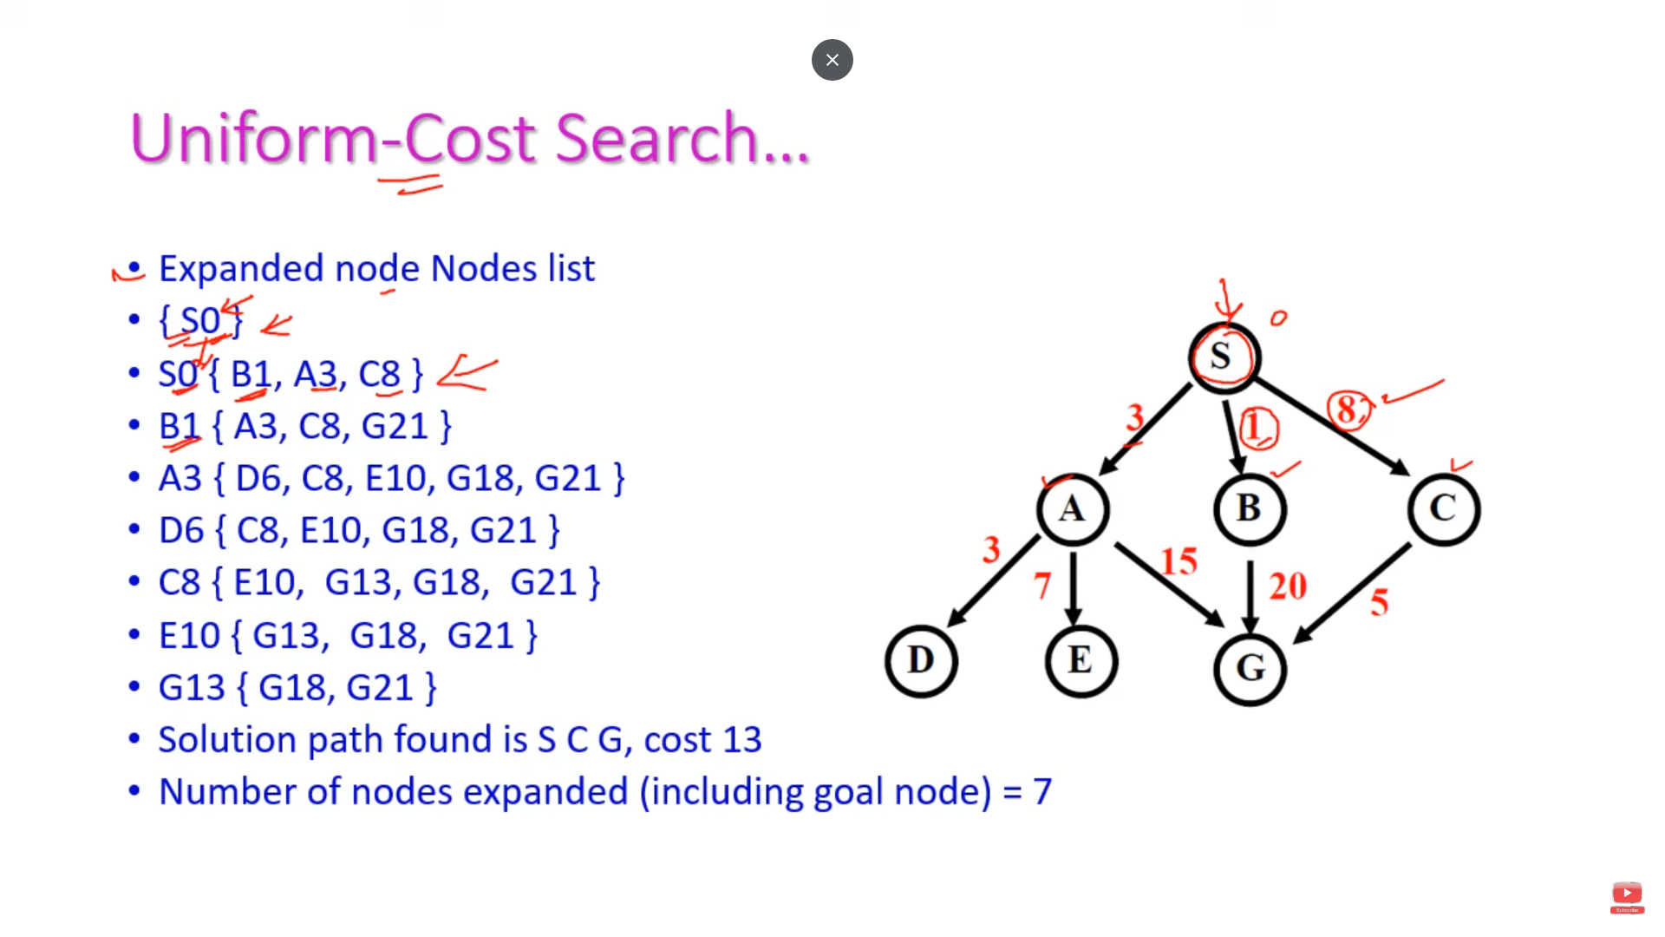

Slide 104
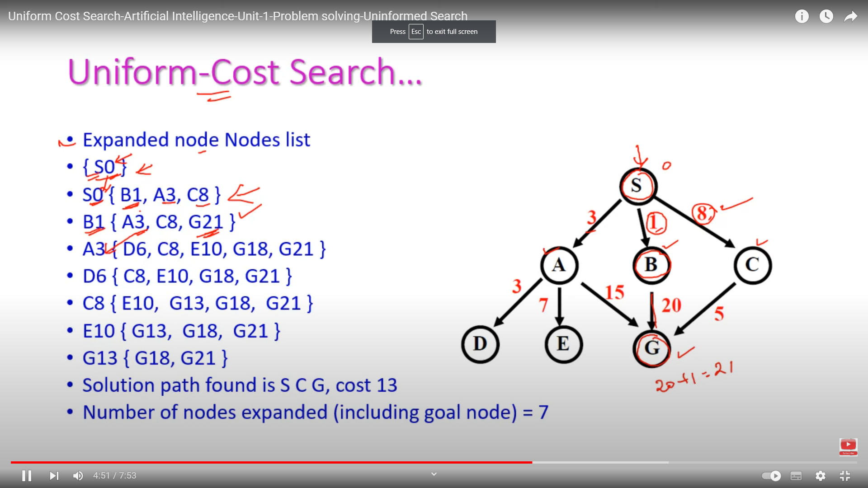

Slide 105
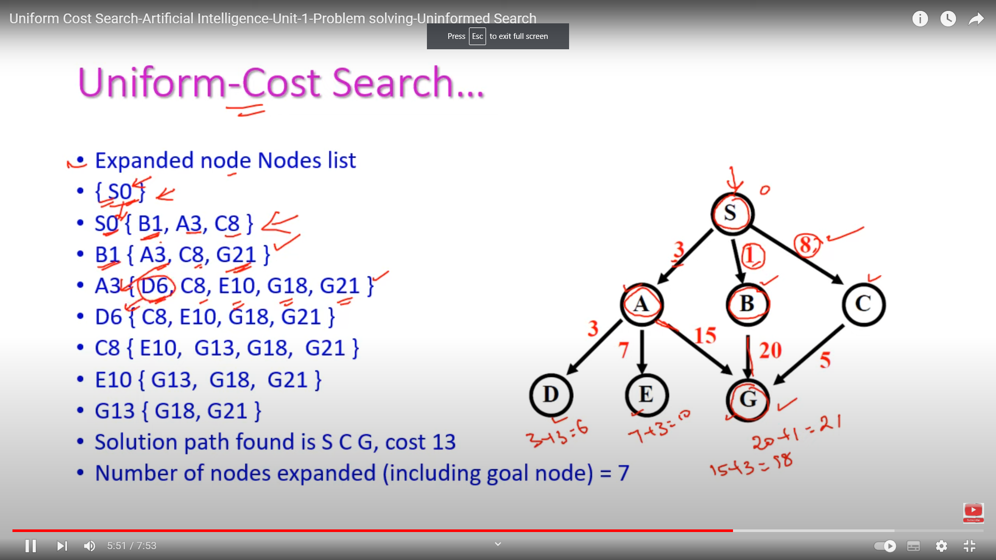

Slide 106
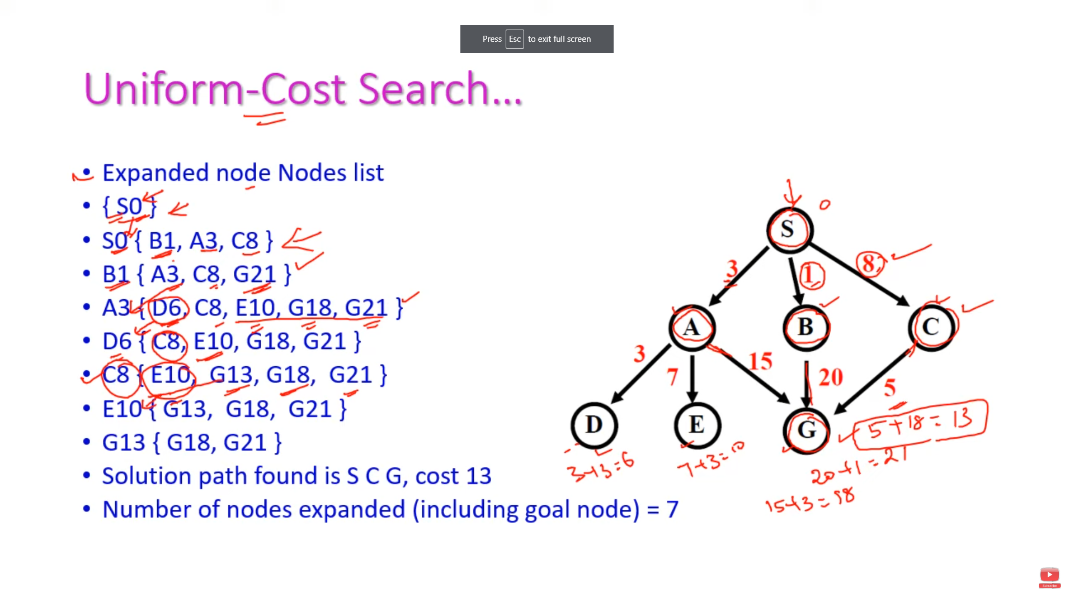

Slide 107
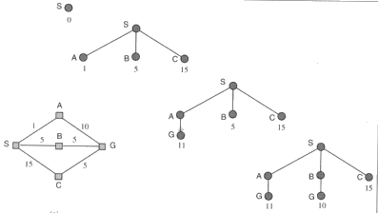
Uniform cost search
the first found solution is guaranteed to be the cheapest
least in depth
But restrict to non-decreasing path cost
Unsuitable for operators with negative cost

Slide 108
Uniform-cost search
Expand least-cost unexpanded node
Implementation:
fringe = queue ordered by path cost
Equivalent to breadth-first if step costs all equal
Complete? Yes, if step cost ≥ ε
Time? # of nodes with g ≤ cost of optimal solution, O(b^{ceiling(C*/ ε)}) where C* is the cost of the optimal solution
Space? # of nodes with g ≤ cost of optimal solution, O(b^{ceiling(C*/ ε)})
Optimal? Yes – nodes expanded in increasing order of g(n)
let C* be the cost of optimal solution.
ε is possitive constant (every action cost)

Slide 109
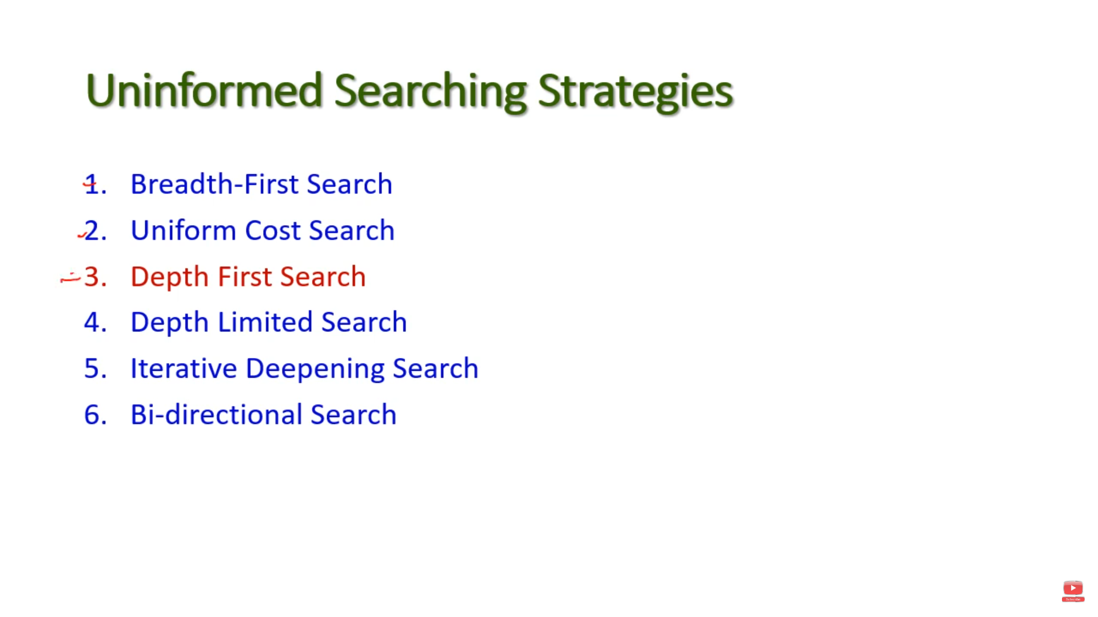

Slide 110
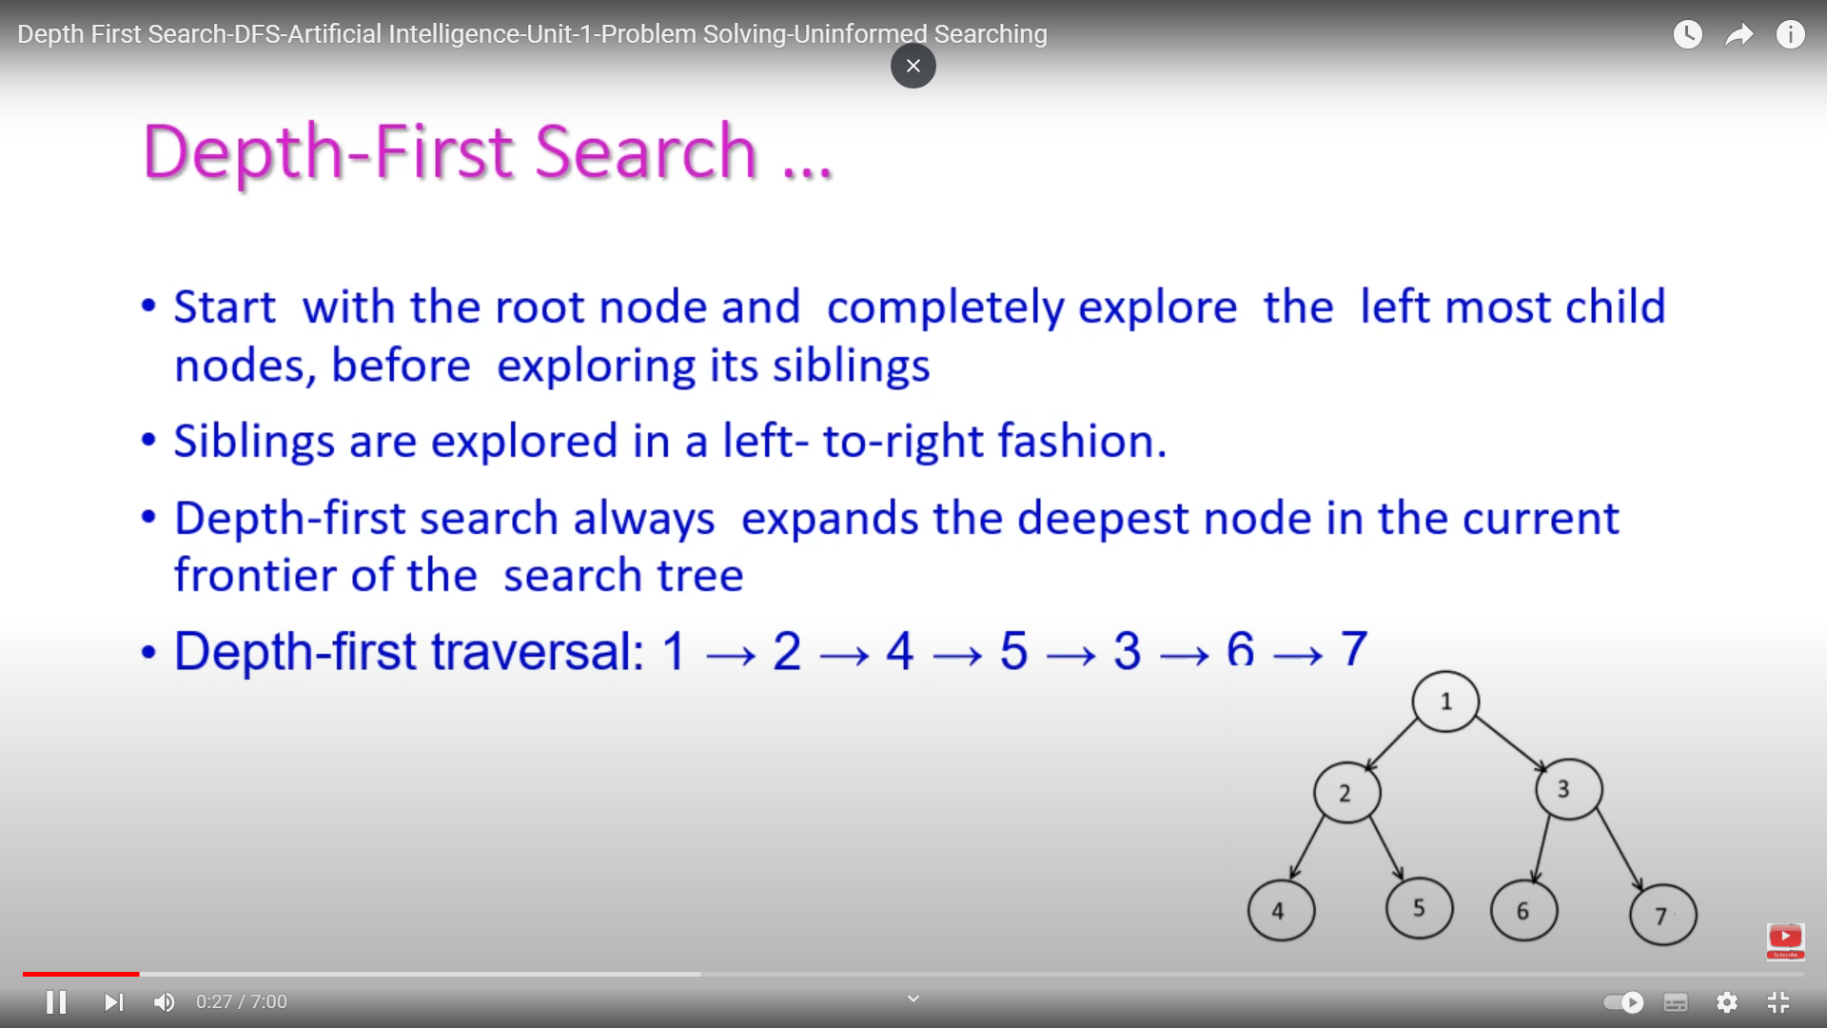

Slide 111
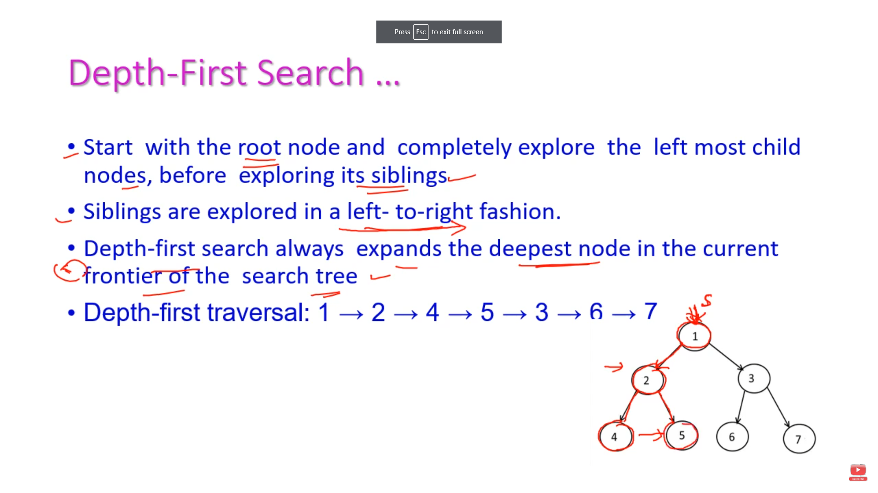

Slide 112
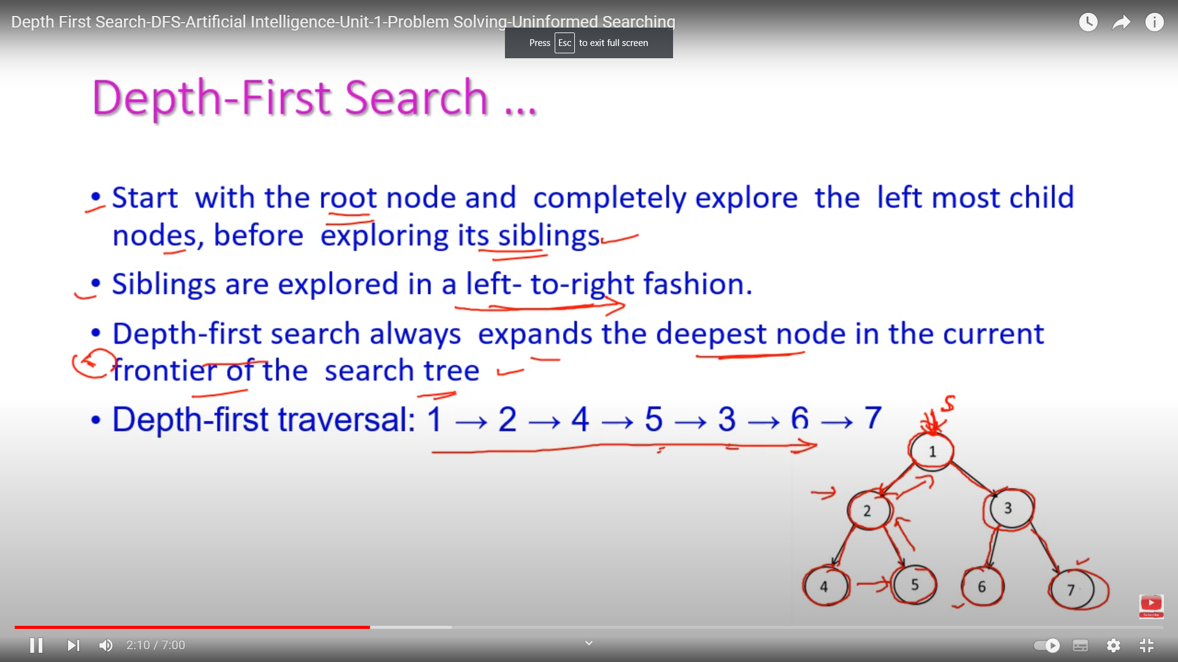

Slide 113
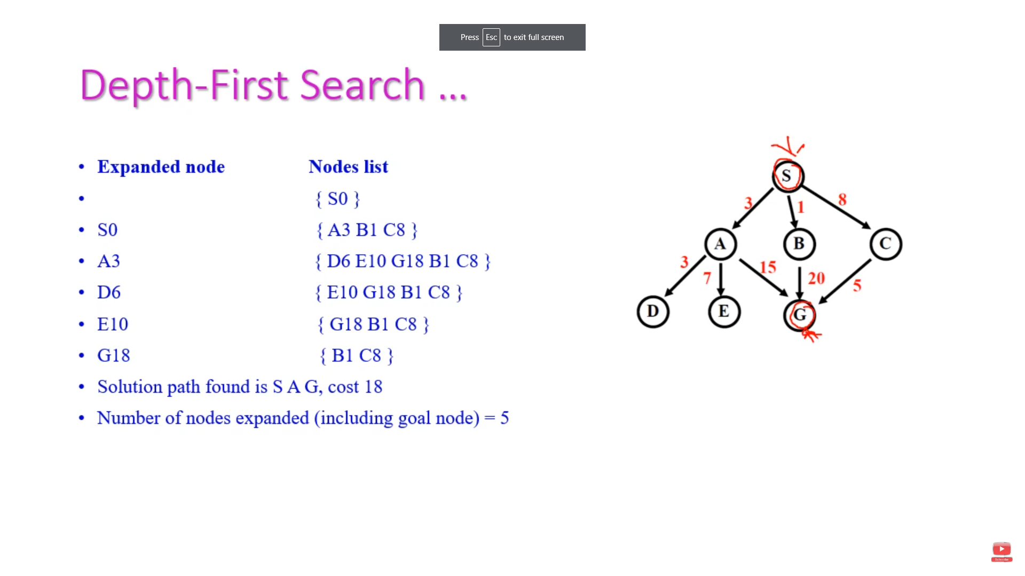

Slide 114
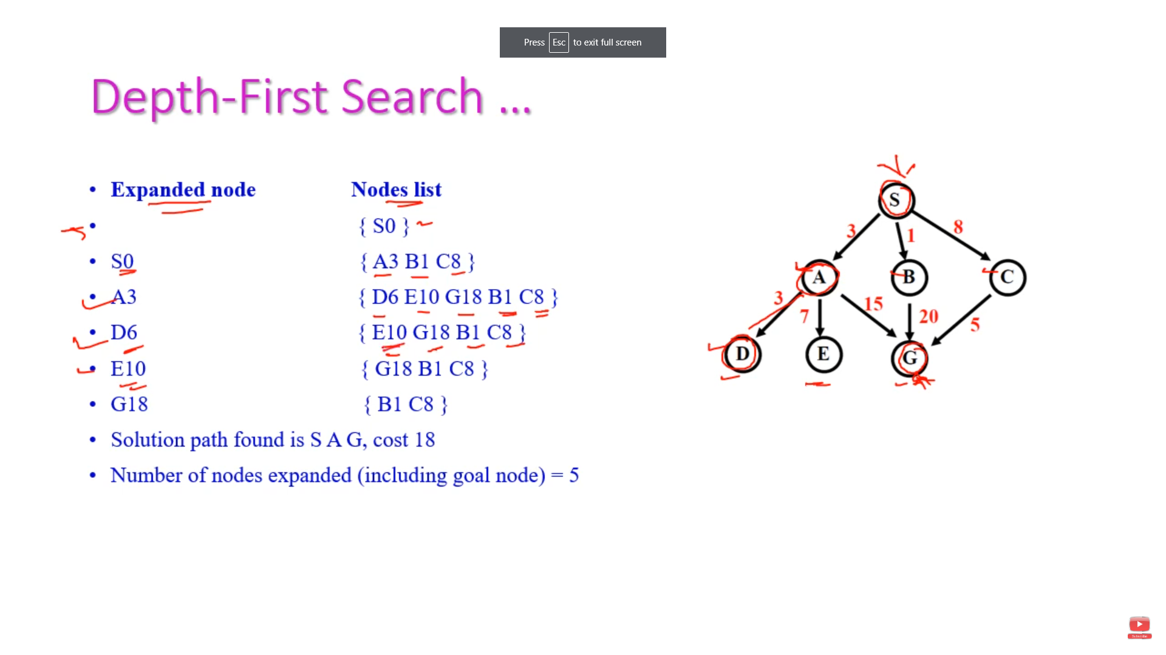

Slide 115
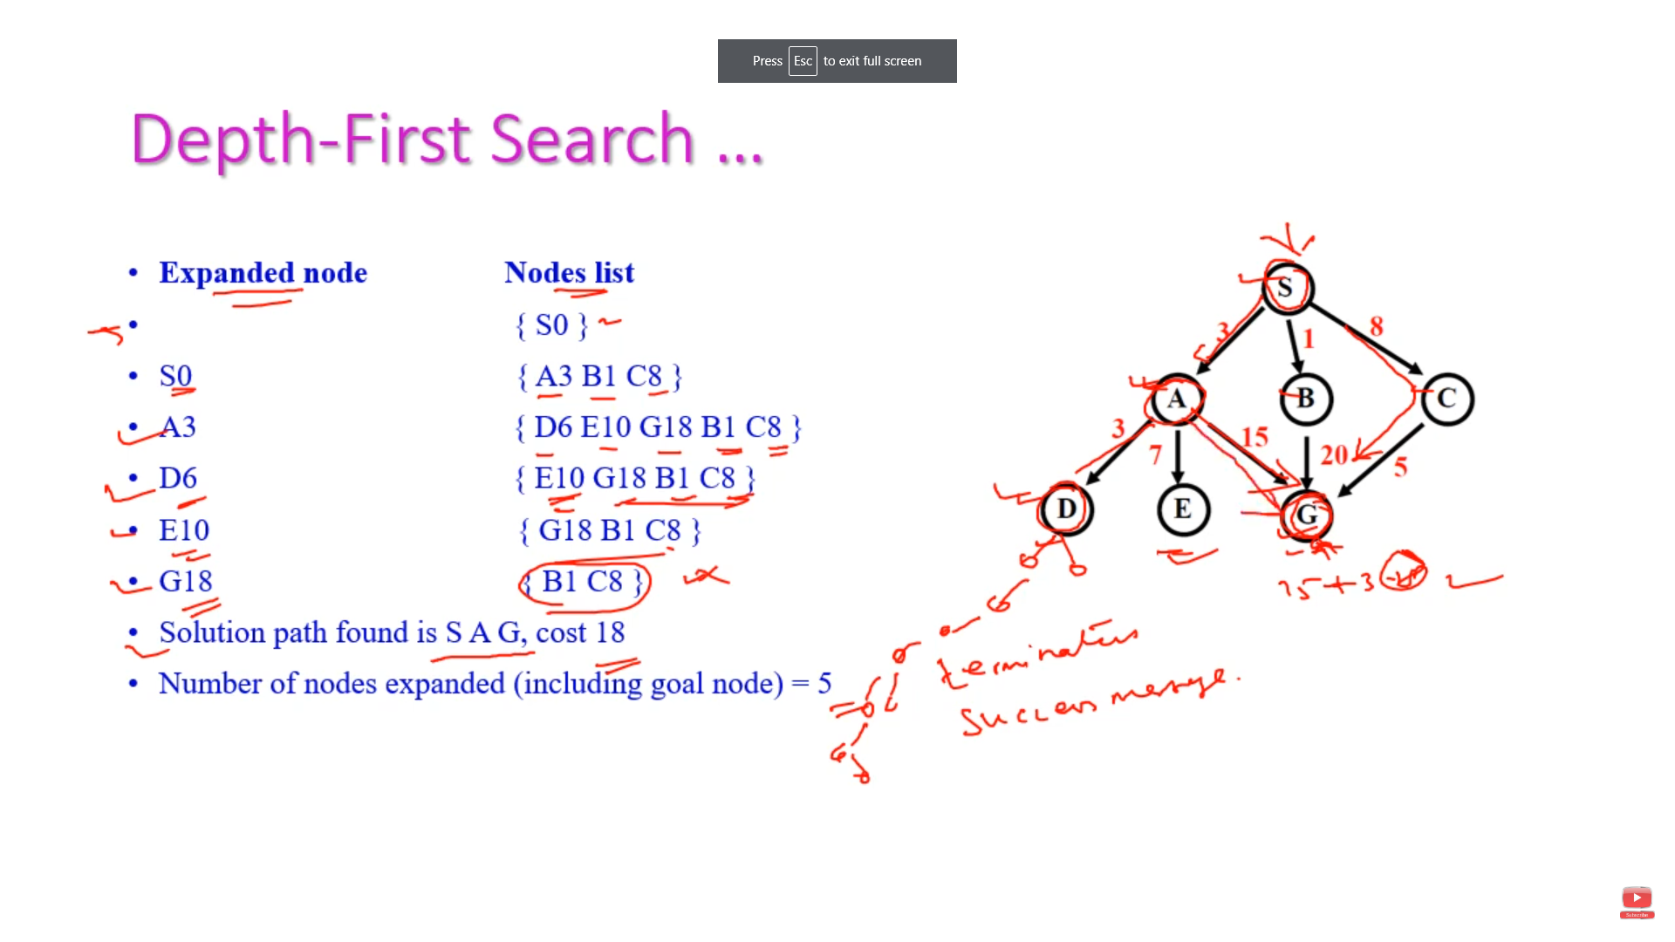

Slide 116
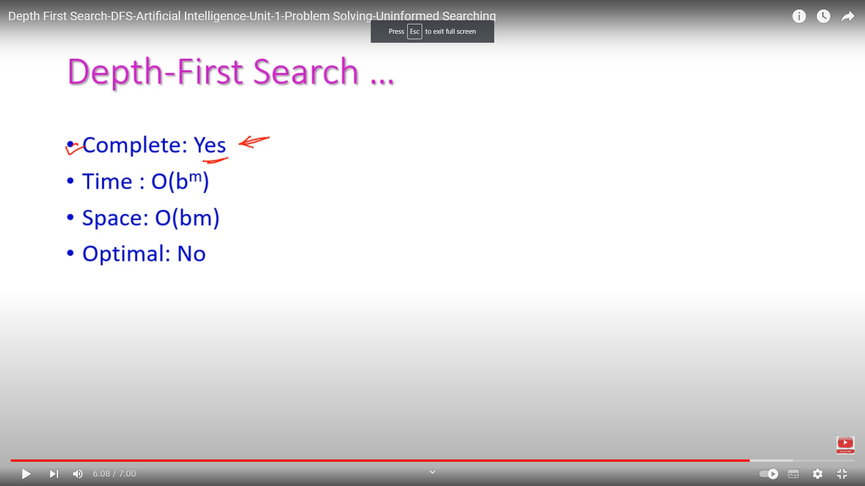

Slide 117
Depth-first search
Always expands one of the nodes at the deepest level of the tree
Only when the search hits a dead end
goes back and expands nodes at shallower levels
Dead end → leaf nodes but not the goal
Backtracking search
only one successor is generated on expansion
rather than all successors
fewer memory

Slide 118
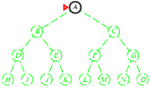
Depth-first search
Expand deepest unexpanded node
Implementation:
fringe = LIFO queue, i.e., put successors at front

Slide 119
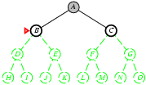
Depth-first search
Expand deepest unexpanded node
Implementation:
fringe = LIFO queue, i.e., put successors at front

Slide 120
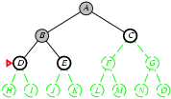
Depth-first search
Expand deepest unexpanded node
Implementation:
fringe = LIFO queue, i.e., put successors at front

Slide 121
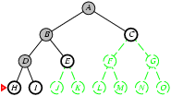
Depth-first search
Expand deepest unexpanded node
Implementation:
fringe = LIFO queue, i.e., put successors at front

Slide 122
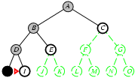
Depth-first search
Expand deepest unexpanded node
Implementation:
fringe = LIFO queue, i.e., put successors at front

Slide 123
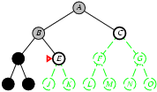
Depth-first search
Expand deepest unexpanded node
Implementation:
fringe = LIFO queue, i.e., put successors at front

Slide 124
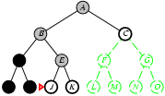
Depth-first search
Expand deepest unexpanded node
Implementation:
fringe = LIFO queue, i.e., put successors at front

Slide 125
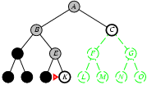
Depth-first search
Expand deepest unexpanded node
Implementation:
fringe = LIFO queue, i.e., put successors at front

Slide 126
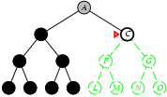
Depth-first search
Expand deepest unexpanded node
Implementation:
fringe = LIFO queue, i.e., put successors at front

Slide 127
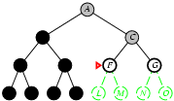
Depth-first search
Expand deepest unexpanded node
Implementation:
fringe = LIFO queue, i.e., put successors at front

Slide 128
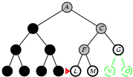
Depth-first search
Expand deepest unexpanded node
Implementation:
fringe = LIFO queue, i.e., put successors at front

Slide 129
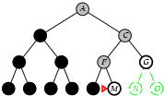
Depth-first search
Expand deepest unexpanded node
Implementation:
fringe = LIFO queue, i.e., put successors at front

Slide 130
Depth-first search
S
A
D
B
D
A
E
C
E
E
B
B
F
11
D
F
B
F
C
E
A
C
G
14
17
15
15
13
G
C
G
F
19
19
17
G
25

Slide 131
Depth-first search (Analysis)
Not complete
because a path may be infinite or looping
then the path will never fail and go back try another option
Not optimal
it doesn't guarantee the best solution
It overcomes
the time and space complexities

Slide 132
Properties of depth-first search
Complete? No: fails in infinite-depth spaces, spaces with loops
Modify to avoid repeated states along path
→ complete in finite spaces
Time? O(b^{m}): terrible if m is much larger than d
but if solutions are dense, may be much faster than breadth-first
Space? O(bm), i.e., linear space!
Optimal? No

Slide 134
Depth-Limited Strategy
Depth-first with depth cutoff k (maximal depth below which nodes are not expanded)
Three possible outcomes:
Solution
Failure (no solution)
Cutoff (no solution within cutoff)

Slide 135
Depth-limited search
It is depth-first search
with a predefined maximum depth
However, it is usually not easy to define the suitable maximum depth
too small → no solution can be found
too large → the same problems are suffered from
Anyway the search is
complete
but still not optimal

Slide 136
Depth-limited search
S
depth = 3
A
D
3
6
B
D
A
E
C
E
E
B
B
F
11
D
F
B
F
C
E
A
C
G
14
17
15
15
13
G
C
G
F
19
19
17
G
25

Slide 137
Iterative deepening search
No choosing of the best depth limit
It tries all possible depth limits:
first 0, then 1, 2, and so on
combines the benefits of depth-first and breadth-first search

Slide 138
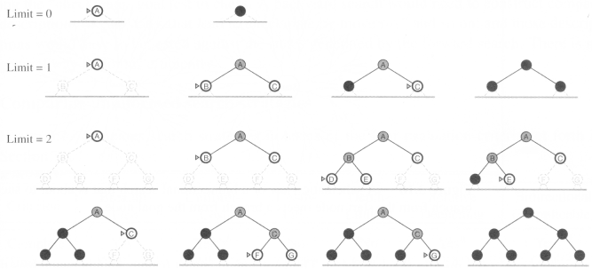
Iterative deepening search

Slide 139
Iterative deepening search (Analysis)
optimal
complete
Time and space complexities
reasonable
suitable for the problem
having a large search space
and the depth of the solution is not known

Slide 140
Properties of iterative deepening search
Complete? Yes
Time? (d+1)b⁰ + d b¹ + (d-1)b² + … + b^{d} = O(b^{d})
Space? O(bd)
Optimal? Yes, if step cost = 1

Slide 141
Iterative lengthening search
IDS is using depth as limit
ILS is using path cost as limit
an iterative version for uniform cost search
has the advantages of uniform cost search
while avoiding its memory requirements
but ILS incurs substantial overhead
compared to uniform cost search

Slide 142
Bidirectional search
Run two simultaneous searches
one forward from the initial state another backward from the goal
stop when the two searches meet
However, computing backward is difficult
A huge amount of goal states
at the goal state, which actions are used to compute it?
can the actions be reversible to computer its predecessors?

Slide 143
Bidirectional Strategy
2 fringe queues: FRINGE1 and FRINGE2
Time and space complexity = O(b^{d/2}) << O(b^{d})

Slide 144
Bidirectional search
S
Forward
A
D
Backwards
B
D
A
E
C
E
E
B
B
F
11
D
F
B
F
C
E
A
C
G
14
17
15
15
13
G
C
G
F
19
19
17
G
25

Slide 145


Slide 146
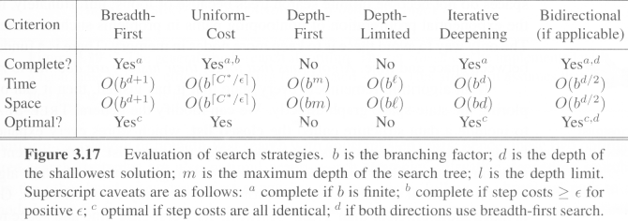
Comparing search strategies

Slide 147

Avoiding repeated states
for all search strategies
There is possibility of expanding states
that have already been encountered and expanded before, on some other path
may cause the path to be infinite → loop forever
Algorithms that forget their history
are doomed to repeat it

Slide 148
Avoiding repeated states
Three ways to deal with this possibility
Do not return to the state it just came from
Refuse generation of any successor same as its parent state
Do not create paths with cycles
Refuse generation of any successor same as its ancestor states
Do not generate any generated state
Not only its ancestor states, but also all other expanded states have to be checked against

Slide 149

Avoiding repeated states
We then define a data structure
closed list:
a set storing every expanded node so far
If the current node matches a node on the closed list, discard it.

